Slide 1
ReLU
Instructor: Dr. Yan Yan

Slide 2

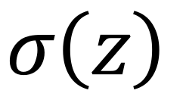
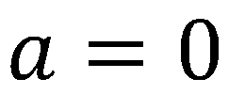
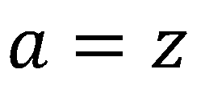

ReLU
Rectified Linear Unit (ReLU)
Reason:
1. Fast to compute
$$a$$
$$σ\left(z\right)$$
$$a=z$$
2. Biological reason
3. Infinite sigmoid with different biases
$$a=0$$
$$z$$
4. Vanishing gradient problem
[Xavier Glorot, AISTATS’11]
[Andrew L. Maas, ICML’13]
[Kaiming He, arXiv’15]

Slide 3
ReLU
$$a$$
$$a=z$$
$$a=0$$
$$z$$
0
0
0
0

Slide 4
ReLU
$$a$$
$$a=z$$
A Thinner linear network
$$a=0$$
$$z$$
Do not have smaller gradients

Slide 5
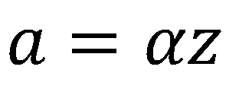
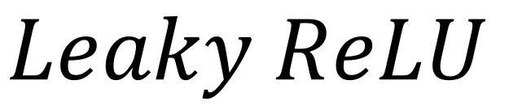
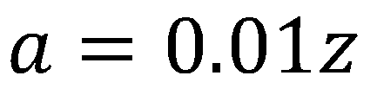
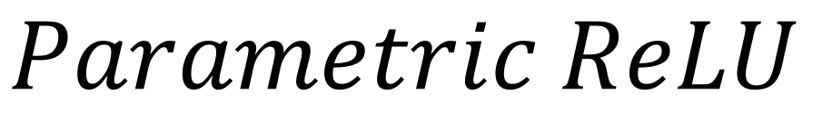
ReLU - variant
$$Leaky ReLU$$
$$Parametric ReLU$$
$$a$$
$$a$$
$$a=z$$
$$a=z$$
$$z$$
$$z$$
$$a=0.01z$$
$$a=αz$$
α also learned by gradient descent

Slide 6










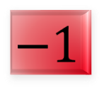

Maxout
ReLU is a special case of Maxout
Learnable activation function [Ian J. Goodfellow, ICML’13]
+
neuron
+
$$5$$
$$1$$
Input
Max
$$7$$
Max
$$2$$
+
$$7$$
+
$$2$$
+
$$−1$$
+
$$4$$
Max
$$1$$
Max
$$4$$
+
$$1$$
+
$$3$$
You can have more than 2 elements in a group.

Slide 7

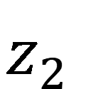


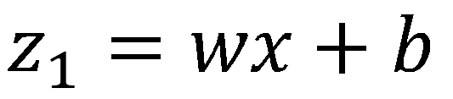
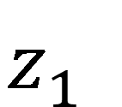

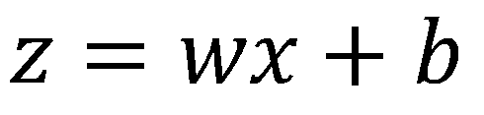
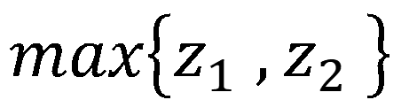
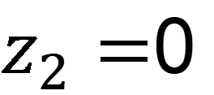
Maxout
ReLU is a special case of Maxout
+
$$z_{1}^{}$$
$$z$$
ReLU
Input
$$w$$
$$a$$
Input
$$w$$
Max
$$b$$
$$a$$
$$0$$
+
$$z_{2}^{}$$
$$max\left\{z_{1}^{},z_{2}^{}\right\}$$
$$b$$
$$0$$
$$a$$
$$a$$
$$z=wx+b$$
$$z_{1}=wx+b$$
$$x$$
$$x$$
$z_{2}=$0

Slide 8
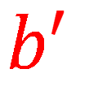

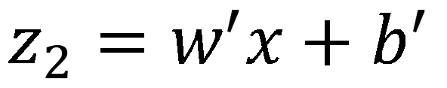
Maxout
More than ReLU
+
$$z_{1}^{}$$
$$z$$
ReLU
Input
$$w$$
$$a$$
Input
$$w$$
Max
$$b$$
$$a$$
+
$$z_{2}^{}$$
$$w^{′}$$
$$max\left\{z_{1}^{},z_{2}^{}\right\}$$
$$b$$
$$b^{′}$$
Learnable Activation Function
$$a$$
$$a$$
$$z=wx+b$$
$$z_{1}=wx+b$$
$$x$$
$$x$$
$$z_{2}=w^{′}x+b^{′}$$

Slide 9
Maxout
Learnable activation function [Ian J. Goodfellow, ICML’13]
Activation function in maxout network can be any piecewise linear convex function
How many pieces depending on how many elements in a group
2 elements in a group
3 elements in a group

Slide 10
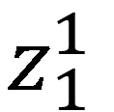
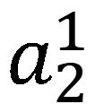
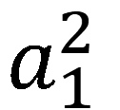
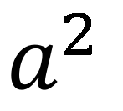

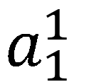
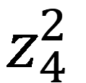
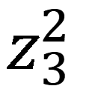
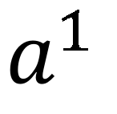
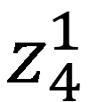
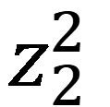
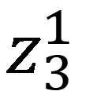
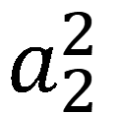
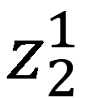
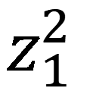

Maxout - Training
Given a training data x, we know which z would be the max
+
$$z_{1}^{1}$$
+
$$z_{1}^{2}$$
Input
Max
$$a_{1}^{1}$$
Max
$$a_{1}^{2}$$
+
$$z_{2}^{1}$$
+
$$z_{2}^{2}$$
$$max\left\{z_{1}^{1},z_{2}^{1}\right\}$$
+
$$z_{3}^{1}$$
+
$$z_{3}^{2}$$
Max
$$a_{2}^{1}$$
Max
$$a_{2}^{2}$$
$$x$$
+
$$z_{4}^{1}$$
$$a^{1}$$
+
$$z_{4}^{2}$$
$$a^{2}$$

Slide 11
Maxout - Training
Given a training data x, we know which z would be the max
Train this thin and linear network
+
$$z_{1}^{1}$$
+
$$z_{1}^{2}$$
Input
$$a_{1}^{1}$$
$$a_{1}^{2}$$
+
$$z_{2}^{1}$$
+
$$z_{2}^{2}$$
+
$$z_{3}^{1}$$
+
$$z_{3}^{2}$$
$$x$$
$$a_{2}^{1}$$
$$a_{2}^{2}$$
+
$$z_{4}^{1}$$
$$a^{1}$$
+
$$z_{4}^{2}$$
$$a^{2}$$
Different thin and linear network for different examples

